Slide 1

MEASURE INTELLIGENCE BEFORE YOU SCALE AUTONOMY
BEYOND AI AGENTS
The Measurable AI Enterprise
From agent deployment to performance optimization, efficiency gains, trust, and accountable autonomy.
Speaker – PVR, CEO & Managing Director.
Notes:
Frame: this is not an agent explainer. The subject is what enterprises manage after agents arrive.

Slide 2
THE AI COST PARADOX
AI is Getting Cheaper.
But Enterprise Intelligence Is Getting More Expensive.
↓ COST PER UNIT OF INTELLIGENCE
COMPUTATIONAL ACTIVITY PER TASK ↑
The A I Cost Paradox
280×
320×
1,000×
73%
Fall in the price of a fixed level of AI performance, in about 18 months
Growth in reasoning-token consumption per organization over 12 months
Token intensity of agentic coding tasks vs. code chat and reasoning
Of organizations exceeded their AI budgets in the past year
The problem is no longer the cost of intelligence. It is the cost of coordinating intelligence at scale.
Notes:
Something very interesting is happening to the economics of artificial intelligence. The cost of delivering intelligence continues to collapse. Yet enterprise AI expenditure is moving in the opposite direction. Why? Because enterprises are no longer asking AI simply to answer questions. We are asking AI to reason. To plan. To retrieve information. To use tools. To access enterprise systems. To collaborate with other agents. To make decisions. And increasingly — to act. Every additional layer of reasoning and action creates another layer of computation. So we have arrived at an apparent contradiction: AI is becoming cheaper, but operating intelligence at enterprise scale is becoming more complex. [Pause] And that changes the question enterprises need to ask. The challenge is no longer AI. The challenge is Enterprise Intelligence.

Slide 3
THE NEW OBSERVABILITY GAP
Every agent produces activity.
Proving performance remains a capability demonstrated by select enterprises.
Task outcomes
Tool calls
LLM traces
Token consumption
Engineering
Security
Additional Aspects:
1. Spend has increased by 40%+
2. Must measure Efficiency / ROI at the Logical unit
3. Comparison strategy: Agentic Workflows vs Traditional Execution
Teams
one version of agent health
another
Latency
Quality evaluations
→
Risk & Governance
Finance / FinOps
Policy events
Security incidents
another
another
Cloud / AI cost
Business outcomes
“So… is the agent healthy?”
An API Interface collects the raw telemetry. DPI-LS calculates the intelligence.
Notes:
Agents already produce evidence: traces, tool calls, latency, tokens, cost. But engineering, security, risk and finance each hold a different version of agent health. Management still asks one question.

Slide 4
APPENDIX · THE CONCEPTUAL INNOVATION
The Agent Performance Contract
Before an enterprise agent receives responsibility, define:
01
02
03
04
What outcome is expected?
What quality is acceptable?
What execution reliability is required?
What cost / token budget is acceptable?
05
06
07
THEN
What security thresholds apply?
Which governance policies are non-negotiable?
What conditions require human escalation?
The scoring engine measures the agent against the contract.
We establish a measurable performance contract for every enterprise agent.
Notes:
Define the contract before the agent receives responsibility. The scoring engine measures the agent against it.

Slide 5
Why is this important?
Without measuring ROI at the logical unit, AI scales as a cost-center rather than a profit-driver.
Example of benefits of measuring ROI:
Top pharma companies like Pfizer measure the exact ROI of their AI systems by tracking time-saved in drug discovery data analysis and regulatory compliance checks against the actual token cost.

Slide 6
1. Science: Competency
The foundational engineering, LLMs, and compute.
2. Art: Collaboration
Prompting, agentic behaviors, and workflows.
3. Security: Maturity
Governance, risk, and compliance.
--> DPI (Formula) - Measuring the balance of all three.

Slide 7
Intelligenz IT – DPI Engine
DPI-LS = (P × Q^1.5 × E) × (G^1.5 × R^2) × C × V
From Telemetry To An Agent Health Score
Every Enterprise Agent Should Have A Performance Score?
CLAIMS AGENT
PERFORMANCE
QUALITY
RELIABILITY
AGENT HEALTH SCORE
Is the agent achieving the objective?
Can we trust the output?
Are actions and tools succeeding?
78
ECONOMICS
SECURITY & RISK
GOVERNANCE
What does the outcome cost?
What exposure is being created?
Is the agent operating within policy?
Token efficiency · Compute cost · Cost per outcome · Cost trend
The score is not the intelligence.
The evidence behind the score is.
VALIDATION
Are required structures, rules and controls being satisfied?
Notes:
Manage an agent like any other critical enterprise resource: a multidimensional health profile, not uptime. If I say 82, your next question is why — so the dimensions and evidence must always be exposed.

Slide 8
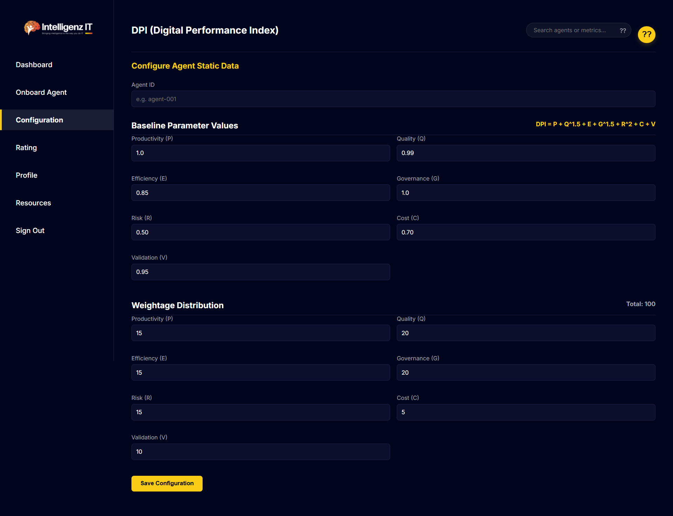

Slide 9
THE ENTERPRISE AGENT CONTROL TOWER (ILLUSTRATION)
One enterprise. One view of the AI workforce.
Agent health should be observable before agent failure becomes visible.
ENTERPRISE AI WORKFORCE
128 Agents
106 Healthy
14 Watch
6 Optimize
2 Restricted
Agent
Health
Perf.
Quality
Cost
Security
Gov.
Trend
78
Claims Agent
Procurement Agent
92
94
96
87
95
97
↑
Performance
Strong
Quality
Watch
Cloud Operations Agent
86
91
88
71
90
92
→
Token efficiency
Strong
Claims Agent
78
83
74
89
72
81
↓
Execution
Strong
Security
Watch
Customer Agent
69
85
68
62
74
70
↓
Governance
Healthy
Validation
Weak
LAST 30 DAYS · CLAIMS AGENT
Token cost ↑ 18% · Validation failures ↑ · Business output stable
RECOMMENDED ACTION
84
83
81
78
The agent still works. But its efficiency and control are deteriorating.
Improve validation before increasing autonomy.
Notes:
One interface instead of five products and five opinions. Scorecards configurable by role and domain; management experience consistent. Claims Agent still works — but validation deteriorating, security exceptions rising, token cost up 18%, business output flat.

Slide 10
APPENDIX · IMPLEMENTATION
Where the scoring layer sits.
INGESTED EVIDENCE
Existing AI agents
Tool calls, LLM traces, quality evaluations, policy events, incidents and cloud / AI cost.
↓
Existing orchestration / runtime
We are not proposing another observability stack.
We are proposing an interpretation layer across the evidence enterprises already generate.
↓
API Interface (Open Telemetry, REST APIs, and MCP integrations)
Designed to work with existing observability, validation, security, governance and cost tooling rather than replacing it.
↓
AGENT SCORING LAYER
↓
Enterprise Agent Dashboard
Notes:
Not another observability stack. An interpretation layer across evidence the enterprise already generates — connected through MCP, APIs and telemetry.

Slide 11
01 · OBSERVE
02 · SCORE
03 · EXPLAIN
ACTIONABLE INTELLIGENCE: MEASURE → DECIDE → IMPROVE
Telemetry, outcomes, cost, security, quality, governance.
Convert evidence into comparable dimensions.
Show what is driving the score.
Measurement should shape agent behaviour and drive continuous improvement beyond dashboards.
Scale
Optimize
Restrict
Investigate
04 · DECIDE
Retrain / Reconfigure
The purpose of scoring is not ranking agents.
The purpose is deciding what responsibility an agent has earned.
05 · IMPROVE
↻ Return to observe
Agent configuration changes.
Continuous Agent Assurance
Notes:
If this is only another dashboard we have solved little. Measurement should change behaviour: strong evidence expands an operating boundary; deteriorating evidence holds or reduces it. Autonomy becomes earned.

Slide 12
APPENDIX · THREE IDEAS TO REMEMBER
What the audience should take away.
1
2
3
Every agent needs a measurable performance contract.
Agent health must be visible at enterprise level, not buried inside technical telemetry.
Greater autonomy should be earned through evidence.
Notes:
If the audience remembers only three things, these are them.

Slide 13
The future of enterprise AI will not be measured by how many agents we deploy.
It will be measured by how confidently we can decide which agents to trust, optimize, restrict and scale.
Every agent observable.
THE MEASURABLE AI ENTERPRISE
Every score explainable.
Every risk visible.
Every optimization evidence-based.
Every increase in autonomy deliberate.
BEYOND AGENTS
Measure Intelligence Before You Scale Autonomy.
Notes:
Close on the two sentences, then the line: measure intelligence before you scale autonomy. Pause between each.

Slide 14
Thank You !
Notes:
If the audience remembers only three things, these are them.

Slide 15
We are building an AI workforce.
Every workforce needs performance management.
YESTERDAY
TODAY
TOMORROW
Can AI do the work?
Can agents execute the work?
Can we prove they should?
Every agent observable.
THE MEASURABLE AI ENTERPRISE
Every score explainable.
Every risk visible.
Every optimization evidence-based.
Every increase in autonomy deliberate.
Notes:
We are building an AI workforce — workforce as an operating metaphor, not an employment claim. Yesterday: can AI do the work. Today: can agents execute it. Tomorrow: can we prove they should.

Slide 16
Measure Intelligence Before You Scale Autonomy
Speaker – PVR, CEO & Managing Director | Intelligenz IT
Notes:
Frame: this is not an agent explainer. The subject is what enterprises manage after agents arrive.

Slide 17
THE QUESTION AFTER AGENTIC AI
Finance Agent
Procurement Agent
Service Agent
Cloud Agent
?
?
?
We know how to build AI agents.
?
HR Agent
Security Agent
Supply Chain Agent
Compliance Agent
The question is: do we know how to measure them?
?
?
?
?
Performing?
Secure?
Cost-efficient?
Compliant?
Deployment tells us the agent exists.
Reliable?
Ready to scale?
Measurement tells us whether it deserves more responsibility.
Notes:
You already know agents, tools, orchestration. Imagine 50 agents. Then 500. Which one is performing? Which is expensive? Which is unreliable? Which deserves more autonomy tomorrow?

